Slide 1
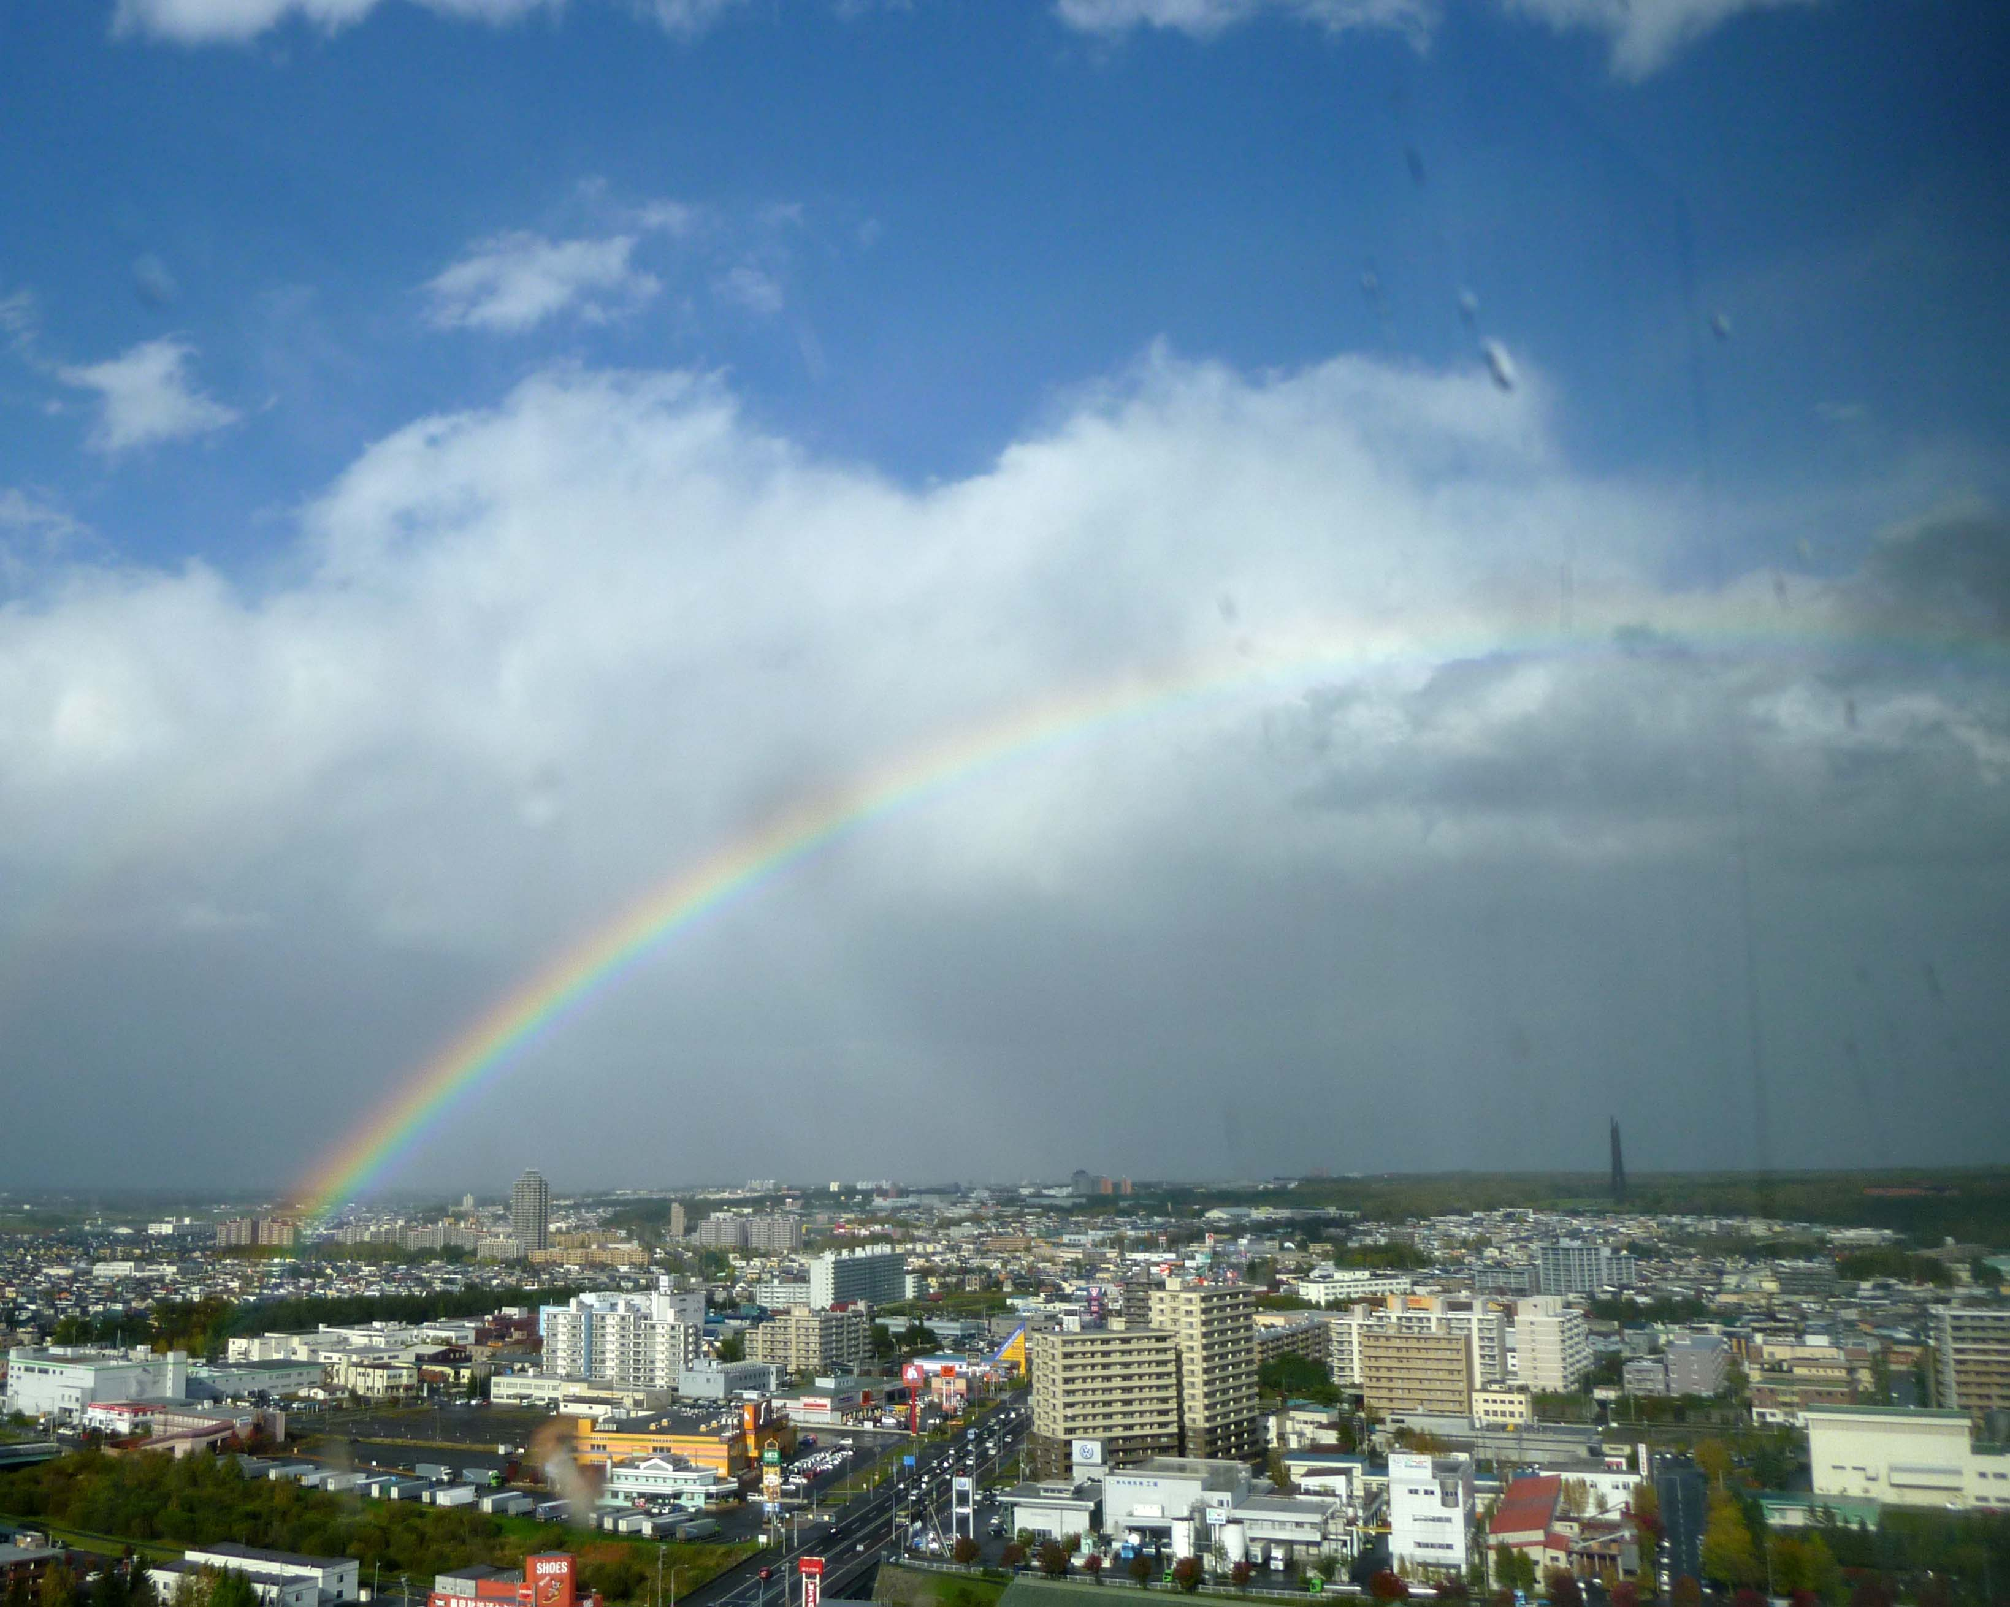
PRAGMA and Networking Seeding the Cloud
View from Sapporo Sheraton Hotel, Monday, Oct 17,2011, 2pm
Maxine Brown
Electronic Visualization Laboratory
University of Illinois at Chicago

Slide 2
Several Ideas…
LambdaGrid (scheduled bandwidth)
versus Grid/Cloud (best-effort bandwidth)
Optical networking
VMs and Green IT
SAGE remote collaborations over GLIF infrastructure
Hybrid (wireless, Internet, optical)
SAGE-Next and the Cloud
Human Augmentics and the Cloud

Slide 3
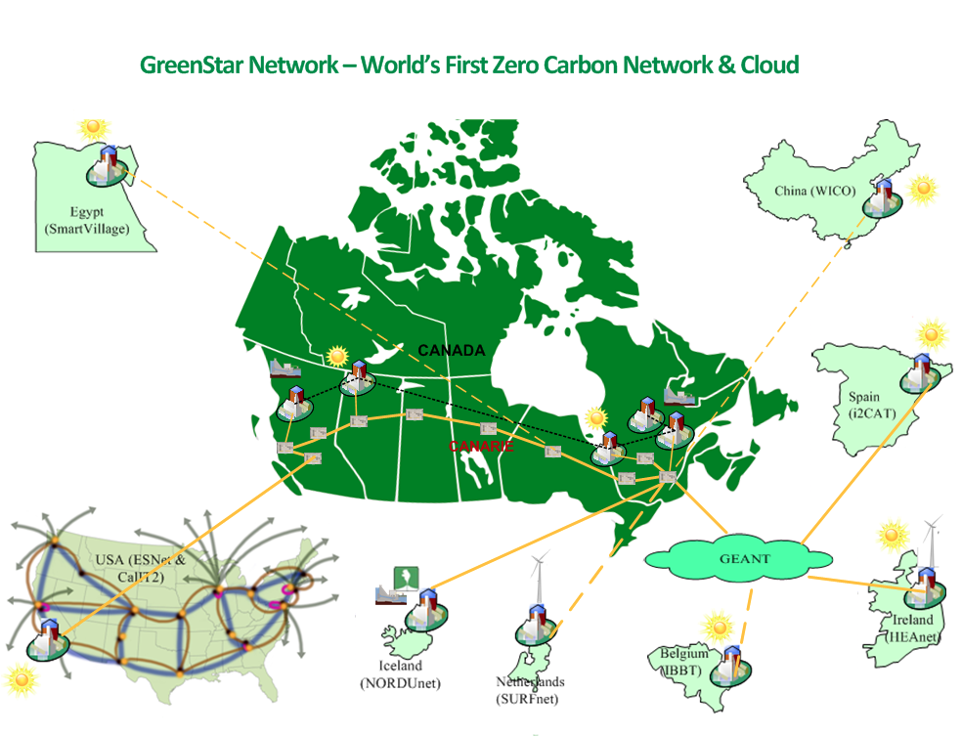
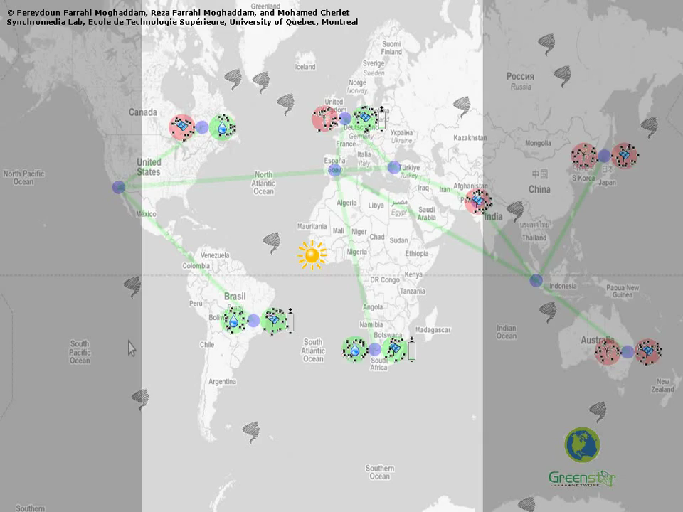
GreenLight / GreenStar Virtual Machines, Green IT and Networking
GreenLight explores how researchers can take advantage of data centers linked by high-speed networking in an era of carbon-thrifty computing
Partnered with Canada’s GreenStar network – researching a “follow the sun/wind” distributed computing environment
Recent studies migrating virtual machines to green energy sites indicate that 100 Gb/s networks are far superior to 10 Gb/s to make this transparent

Slide 4
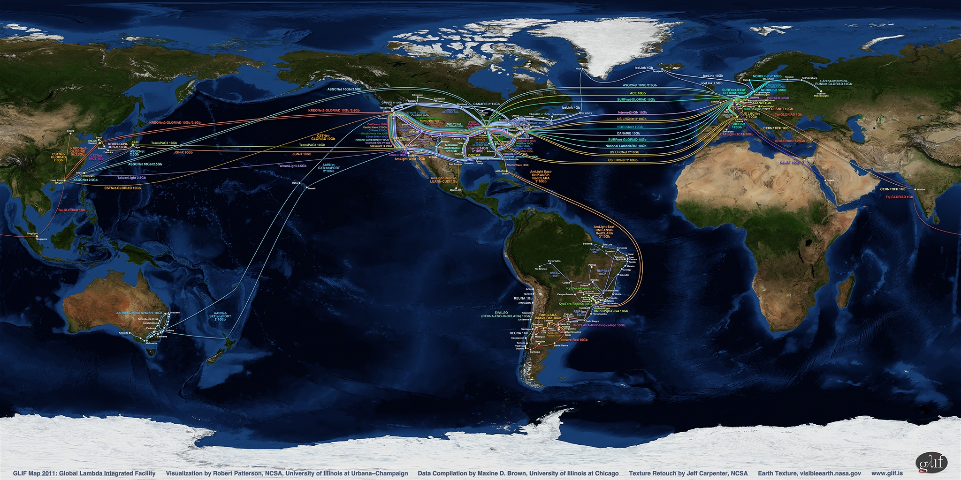
SAGE Remote Collaboration Using the GLIF Infrastructure
www.glif.is

Slide 5
SAGE-Next
Multi-user interaction-based resource manager that takes advantage of multi-core processors – to drive a tiled display with a single computer
Enable interaction with applications, including cloud-based services; clouds enable distance collaboration and document sharing
More at SC11: SAGE Meeting, Tuesday, November 15, 12:15pm - 1:15pm, WSCC Room 613 / 614

Slide 6
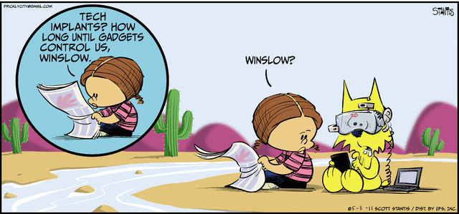
Human Augmentics www.augmentics.org
Technologies for expanding the capabilities and characteristics of humans

Slide 7
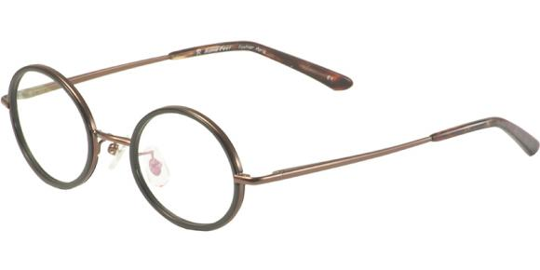
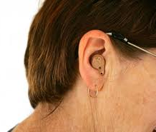
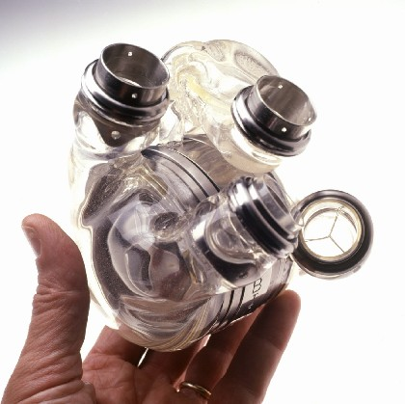
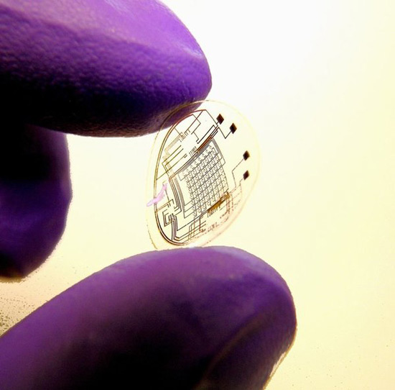
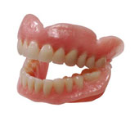
Human Augmentics
Early Pro genitors
Prostheses
Dean Kamen – DEKA Research RoboHand
Artificial Heart
Contact Lens
False Teeth

Slide 8
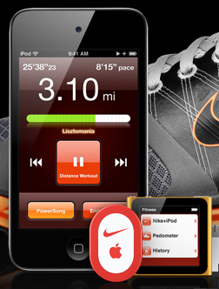

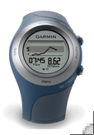
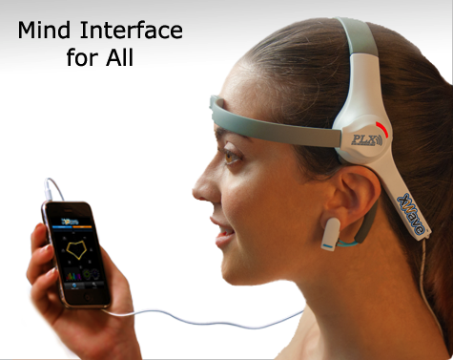
Today: Personal Sensors
Nike+
Bodymedia
Under Armor Data Gathering Workout Suit
Garmin Forerunner
PLX - XWave

Slide 9
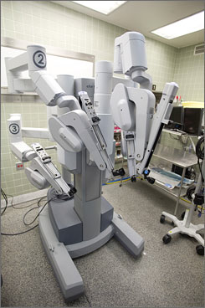
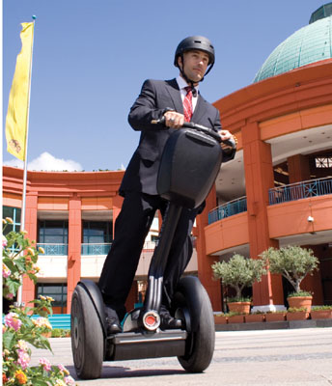
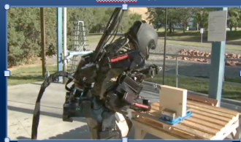
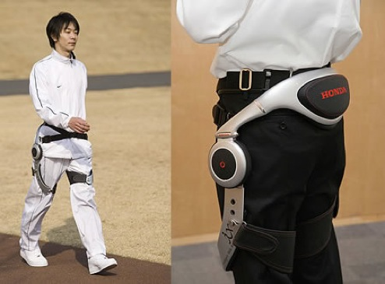

Today: Robotics
Da Vinci
Segway
Ratheon XOS2
Emovere
Wearable Chariot
Cyberdyne – Hybrid Assistive Limb
Honda Assistive Walker

Slide 10
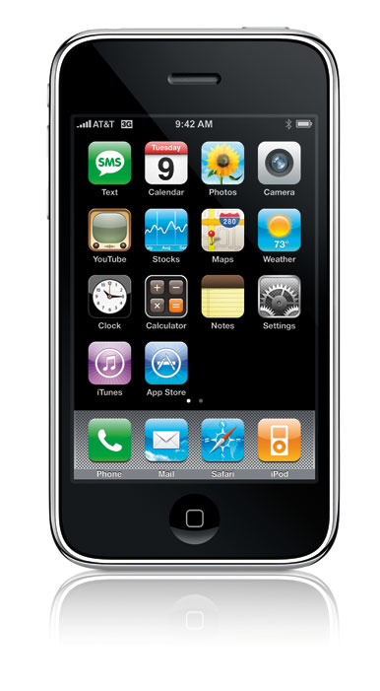
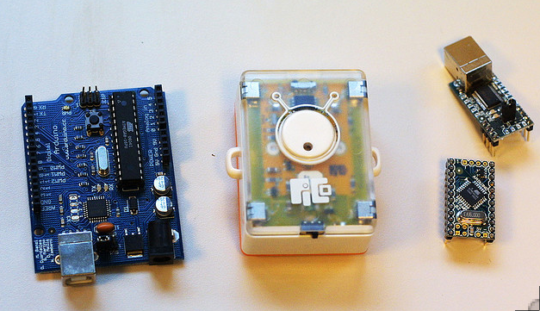
Miniaturized Computation
iPhone
Arduino, Pico, STAMP
U of Michigan
1 cubic mm computer

Slide 11
3 Tenets of Human Augmentation
Based on an understanding of human sensory, cognitive & physical limitations, so that augmentations are applied appropriately, ethically, responsibly
Key enabler – exponential advances in technology
Ecosystem of networked humans, human augmentics technology & the environment (in the Cloud) uses shared intelligence to amplify/augment human capabilities beyond evolution
Notes:
Finally we believe that the full capabilites of HA will be unleashed when there is a networked ecosystem of humans, tech and the environment.
This will allow us to improve ourselves in ways beyond what evolution will allow us to do.

Slide 12

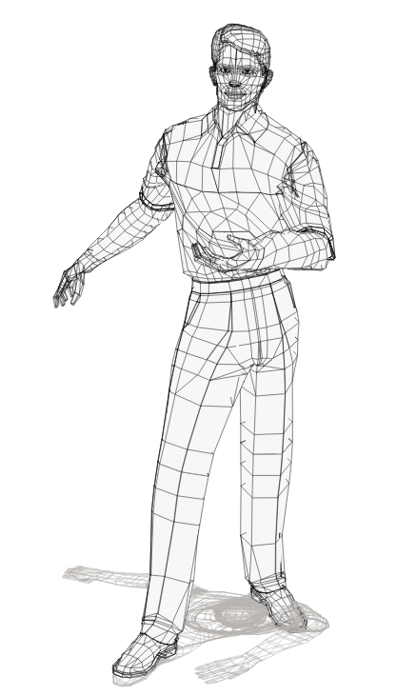


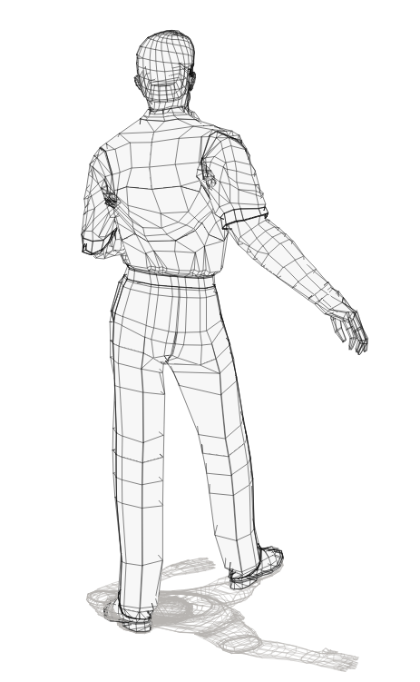

3rd Tenet of Human Augmentics: The Human, Augmentics, Environment, Cloud Ecosystem is Necessary for Continual Evolution
The Local
Environment
The Global
Environment
Data from
environment
Data from
environment
The Cloud
Human Augmentics
Device(s)
Human receives augmentation
Data transmitted
& received
from Cloud
Data from
human
Other Augmented
Humans
Image: Jason Leigh, UIC/EVL, 2011
Notes:
Where HA will take off is when there is an ecosystem of
Humans, HA technologies, sensors in the environment, all networked
That is growing in intelligence

Slide 13
An Emerging Area…
Augmented Human Conference http://www.augmented-human.com/
1st IEEE EMBS (Biomedical and Health Informatics) workshop on Wearable & Ubiquitous Technology for Health & Wellness http://embc2011.embs.org/unconference/program/
Singularity Institute for Artificial Intelligence http://singinst.org
EVL to hold first UIC course in Spring 2012
EVL to organize a global workshop in this domain

